Slide 1
Migrating Databases Hands On Lab

Slide 2
Migrating databases to azure
Hands on Lab Scenario
Awesome Trading inc. is an online trading company. Founded in 2008;
Customer has Legacy VB6 application called “Online Transaction Monitor” that uses a legacy SQL 2008 Database Server. Due to compliance this needs upgrading.
Customer cannot make application changes as source code is misplaced. Connection string updates only.
Customer would like to reduce impact on support staff and not worry about patching and management of the infrastructure
Databases require 99.99% SLA
Hands on SQL Migration– Time (1 Hour)
Provide a PoC of a working application which has its databases migrated to latest versions of SQL, meeting the requirements above
PoC can be built with an offline migration using DMS
Within your teams, work with proctors to gain access to your lab

Slide 3
Migrating databases to azure
Server IP (BY TEAM):
GET into Teams of 2 - 4
Get Access to your Team VM
Login using MSTSC, Enter the IP address
Username: Demouser
Password: Demo@pass1234567
Lab instructions and Step by step guide C:\_SQLHACK_\LABS\01-Data_Migration
TBC

Slide 4
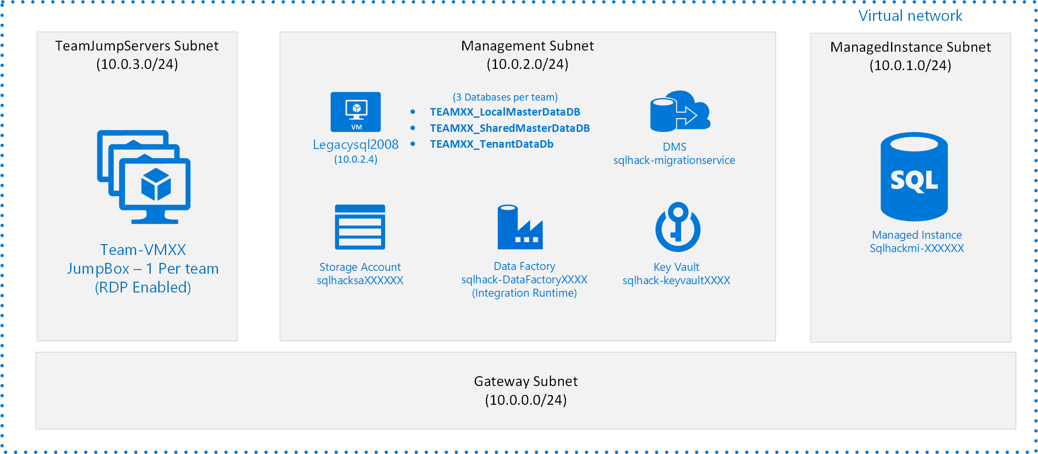
Migrating databases to azure
LAB TASKS
Lab instructions and Step by step guide C:\_SQLHACK_\LABS\01-Data_Migration
Test the Online Transaction Monitor Application
Plan your 3 databases for migration using DMA
Use the Database Migration Service to Migrate your 3 Databases and Logins
Test your Migration by using the Online Transaction Monitor Application
Optimise any Errors
LAB ARCHITECTURE
Your Databases will be Prefixed: TEAMXX_
Only move the databases with your team name on
This is a shared environment, please do not create any new resources without proctor approval.

